Slide 1
Data Science
By OWOLABI ADEBAYO, A SOFTWARE ENGINEER
GETBUNDI

Slide 2
Disclaimer: These slides are copyrighted and strictly for personal use only
This document is reserved for people enrolled into the Data Science Course by Owolabi Adebayo
Please do not share this document, it is intended for personal use and exam preparation only, thank you.

Slide 3
Whats Data Science?
Data Science is defined as a scientific field that uses scientific methods to extract knowledge and insights from structured and unstructured data, and apply knowledge and actionable insights from data across a broad range of application domains.
This definition highlights the following important aspects of data science:
The main goal of data science is to extract knowledge from data, in other words - to understand data, find some hidden relationships and build a model.
Data science uses scientific methods, such as probability and statistics. In fact, when the term data science was first introduced, some people argued that data science was just a new fancy name for statistics. Nowadays it has become evident that the field is much broader.
Obtained knowledge should be applied to produce some actionable insights, i.e. practical insights that you can apply to real business situations.
We should be able to operate on both structured and unstructured data. We will come back to discuss different types of data later in the course.
Application domain is an important concept, and data scientists often need at least some degree of expertise in the problem domain, for example: finance, medicine, marketing, etc.

Slide 4
What we’ll learn in this course
The history of DS
Statistics
The Data Science Process
Visualization
Interview with Nadieh Bremer
Databases
Statistical Learning & Meet Hadelin de Ponteves
Machine Learning
Deep Learning
Deep Learning and Computer Vision
Deep Learning and NLP
Artificial Intelligence
Data Science for tableau
Data Science for python
Data Science for cloud

Slide 5
Getting started with Data Science
Configuring your machine properly is essential for data science and working with tools like Tableau and cloud-based data science platforms. In this set of videos, you'll learn step-by-step instructions on how to set up your machine for data science tasks. These videos cover topics such as installing necessary software, configuring development environments, and optimizing your machine for data analysis and visualization.
Learn Python. It's also recommended to have a basic understanding of Python, a programming
language useful for data scientists that we use in this course.
Create a GitHub account. Since you found us here on GitHub, you might already have an
account, but if not, create one and then fork this curriculum to use on your own. (Feel free to give
us a star, too 😊 )
Explore Scikit-learn. Familiarize yourself with Scikit-learn, a set of ML libraries that we reference
in these lessons.

Slide 6
Statistics
Statistics is a branch of mathematics that deals with collecting, analyzing, interpreting, presenting, and organizing data. It provides techniques for summarizing and describing data, drawing inferences, and making predictions. In data science, statistics plays a vital role in understanding data patterns, testing hypotheses, and making data-driven decisions.

Slide 7
The Data Science Process
The data science process refers to the systematic approach followed by data scientists to solve problems using data. It involves various stages, including data collection, data cleaning and preprocessing, exploratory data analysis, feature engineering, model building, model evaluation, and deployment. The data science process is iterative and involves continuous refinement and improvement of models and insights.

Slide 8
Techniques of Data Science
1. Decide on the question. Most DS processes start by asking a question that cannot be answered
by a simple conditional program or rules-based engine. These questions often revolve around
predictions based on a collection of data.
2. Collect and prepare data. To be able to answer your question, you need data. The quality and,
sometimes, quantity of your data will determine how well you can answer your initial question.
Visualizing data is an important aspect of this phase. This phase also includes splitting the data
into a training and testing group to build a model.
3. Choose a training method. Depending on your question and the nature of your data, you need to
choose how you want to train a model to best reflect your data and make accurate predictions
against it. This is the part of your DS process that requires specific expertise and, often, a
considerable amount of experimentation.

Slide 9
Techniques of Data Science
4. Train the model. Using your training data, you'll use various algorithms to train a model to
recognize patterns in the data. The model might leverage internal weights that can be adjusted to
privilege certain parts of the data over others to build a better model.
5. Evaluate the model. You use never before seen data (your testing data) from your collected set to
see how the model is performing.
6. Parameter tuning. Based on the performance of your model, you can redo the process using
different parameters, or variables, that control the behavior of the algorithms used to train the
model.
7. Predict. Use new inputs to test the accuracy of your model.

Slide 10
Pre-building tasks
Data are two things you need to do at this point:
1. Collect data. Keeping in mind the previous lesson on fairness in data analysis, collect your data
with care. Be aware of the sources of this data, any inherent biases it might have, and document
its origin.
2. Prepare data. There are several steps in the data preparation process. You might need to collate
data and normalize it if it comes from diverse sources. You can improve the data's quality and
quantity through various methods such as converting strings to numbers (as we do in Clustering).
You might also generate new data, based on the original (as we do in Classification). You can
clean and edit the data (as we did prior to the Web App lesson). Finally, you might also need to
randomize it and shuffle it, depending on your training techniques.

Slide 11
Selecting your feature variable
Feature Selection and Feature Extraction How do you know which variable to choose when
building a model? You'll probably go through a process of feature selection or feature extraction to
choose the right variables for the most performant model. They're not the same thing, however:
"Feature extraction creates new features from functions of the original features, whereas feature
selection returns a subset of the features.

Slide 12
Visualize your data & Split your dataset
An important aspect of the data scientist's toolkit is the power to visualize data using several
excellent libraries such as Seaborn or MatPlotLib.
Training. This part of the dataset is fit to your model to train it. This set constitutes the majority of
the original dataset.
Testing. A test dataset is an independent group of data, often gathered from the original data,
that you use to confirm the performance of the built model.
Validating. A validation set is a smaller independent group of examples that you use to tune the
model's hyperparameters, or architecture, to improve the model. Depending on your data's size
and the question you are asking, you might not need to build this third set

Slide 13
Building a model
Train a model
Armed with your training data, you are ready to 'fit' it to create a model. You will notice that in many
ML libraries you will find the code 'model.fit' - it is at this time that you send in your data as an array
of values (usually 'X') and a feature variable (usually 'y’).
Evaluate the model
Once the training process is complete (it can take many iterations, or 'epochs', to train a large model),
you will be able to evaluate the model's quality by using test data to gauge its performance. This data
is a subset of the original data that the model has not previously analyzed. You can print out a table of
metrics about your model's quality.

Slide 14
Parameter tuning
Prediction
This is the moment where you can use completely new data to test your model's accuracy. In an
'applied' ML setting, where you are building web assets to use the model in production, this process
might involve gathering user input (a button press, for example) to set a variable and send it to the
model for inference, or evaluation.

Slide 15
Visualization
Visualization is the process of representing data and information visually through charts, graphs, and other visual elements. Data visualization helps in understanding complex patterns, trends, and relationships within data. It enhances data exploration, communication, and storytelling. Data scientists use various visualization techniques to present insights effectively and aid decision-making.

Slide 16
Interview with Nadieh Bremer
In this interview, we have the opportunity to hear from Nadieh Bremer, a renowned data visualization expert. Nadieh shares her insights and experiences in the field of data visualization, discussing the importance of effective storytelling through visualizations, the role of creativity in data visualization, and the impact of visualization in communicating complex ideas.

Slide 17
Databases
Databases are structured collections of data that are organized, managed, and stored for efficient retrieval and manipulation. In data science, databases serve as crucial repositories for storing and accessing large volumes of data. Data scientists work with various types of databases, such as relational databases, NoSQL databases, and distributed databases, to extract and analyze data for insights and modeling.

Slide 18
Statistical Learning & Meet Hadelin de Ponteves
Statistical learning involves the development of models and algorithms that learn patterns and relationships from data. It combines statistical techniques with machine learning approaches to make predictions and decisions based on observed data. In this section, we introduce Hadelin de Ponteves, a renowned expert in statistical learning, who shares insights into the field and discusses the practical applications of statistical learning in data science.

Slide 19
Machine Learning
Machine learning is a subset of artificial intelligence that focuses on enabling computers to learn from data and make predictions or take actions without being explicitly programmed. It involves the development of algorithms and models that automatically improve and adapt through experience. Machine learning techniques are widely used in data science for tasks such as classification, regression, clustering, and recommendation systems.

Slide 20
Deep Learning
Deep learning is a specialized branch of machine learning inspired by the structure and function of the human brain's neural networks. It involves the development of artificial neural networks with multiple layers that can learn hierarchical representations of data. Deep learning has achieved remarkable success in various domains, including image recognition, natural language processing, and speech recognition.

Slide 21
Deep Learning and Computer Vision
Deep learning has revolutionized the field of computer vision, enabling machines to understand and interpret visual data. Computer vision focuses on teaching computers to see and understand images or videos. Deep learning models, such as convolutional neural networks (CNN

Slide 22
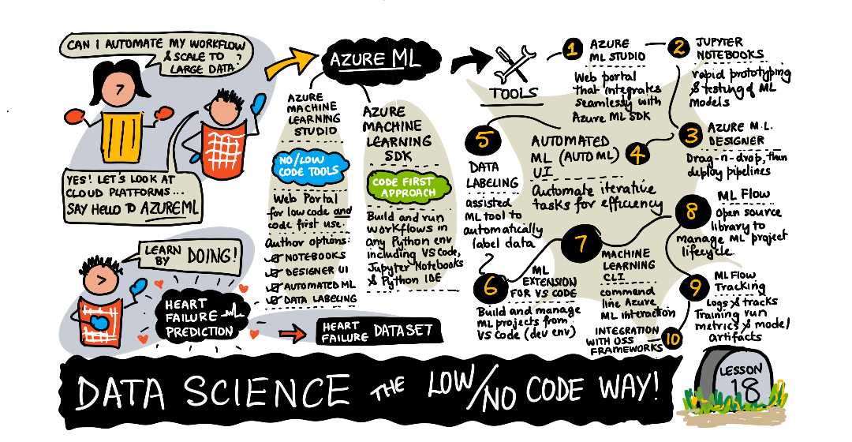
Installation of Visual Studio Code with Snippets
Let GO AND CODE IT OUT

Slide 23
